Slide 1

LABORATORY FLOOR CLEANING MACHINE
Group R3
Faculty of Engineering
University of Jaffna

Slide 2
Objective
The objective of the project is to create a floor cleaning machine which can do sweeping, mopping and drying I the laboratory. And also the machine will be eco friendly and want to create using eco friendly products. So we’ll try our best to give a innovative environmental friendly floor cleaning machine.

Slide 3
Tasks
Wood works for create the frames.
Arduino works for remote control system.
Welding the joint and the other components such as mop, drier, broom and tighten the screws.
Mechanical works such as create the individual components and fix together in the frame.
Electrical work using wire and others to operate the machine and also do the sweeping , mopping and drying.

Slide 4
Task Allocation Among Group
1. Wood works for create the frames.
2. Aurdino works for remote control system.
3. Welding the joint and the other components such as mop, drier, broom and tighting the screws.
4. Mechanical works such as create the individual components and fix together in the frame.
5. Electrical work using wire and others to operate the machine and also do the sweeping, mopping and drying.

Slide 5
Proposed Drawings For Floor Cleaning Machine

Slide 6
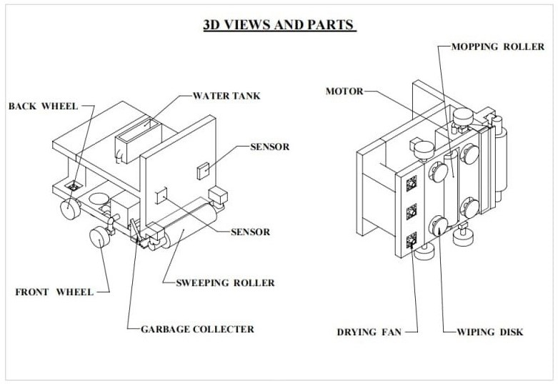

Slide 7
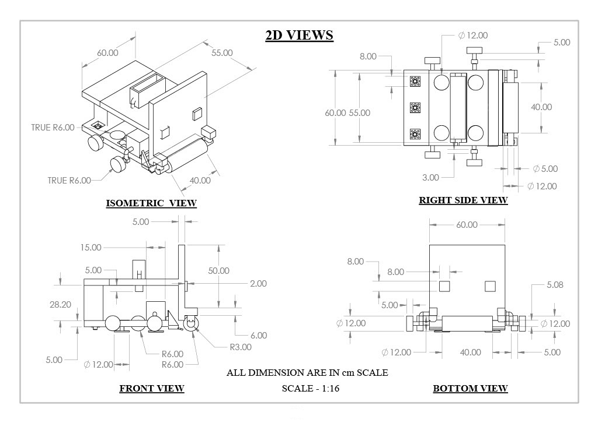

Slide 8
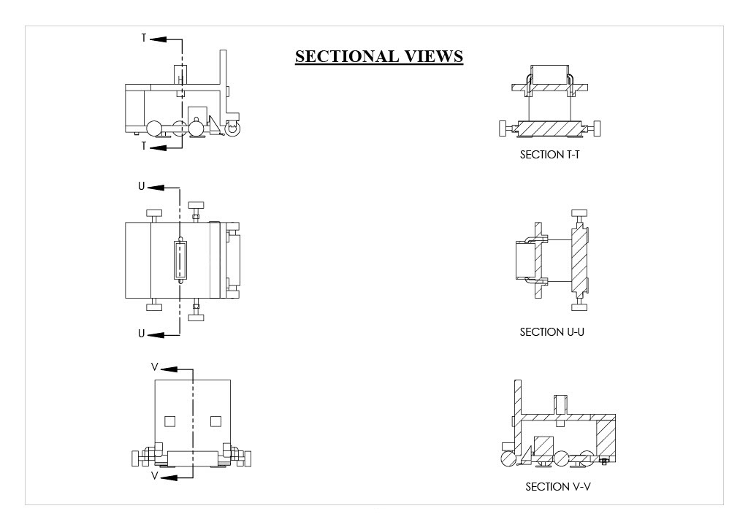

Slide 9
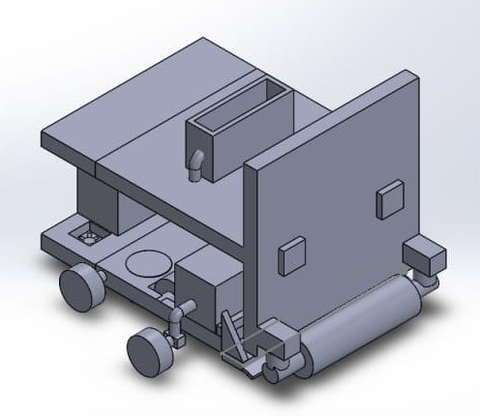
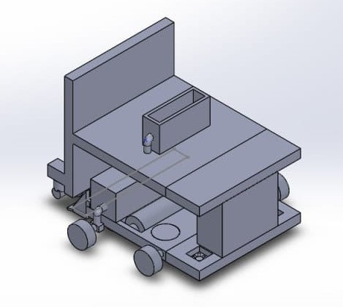
Proposed Prototype

Slide 10
List of Components
1. Sweeping roller : - It is used to sweep the laboratory floor .It works with the help of the motor and also it rotates the opposite direction of the machine moving.
2. Mopping roller : - It is used to mop the floor .The water for the mopping process come from the water tank which is at the top of the roller .From the help of that it can mop.
3. Wiping disk : - It is used to dry the floor by wiping the floor in a rotation.
4. Drying fan : - It is also used to additional drying process.
5. Water tank :- The water is stored here.
6. Sensors :- To identify the objects and also avoid colliding with them .
7. Garbage collecter : - To collect the carbages which is sweeped by the sweeping roller.

Slide 11
Mechanism
It works under 3 process. First the roller in the front of the machine will sweep the garbage in the laboratory and push behind the garbage collecter.
Then the mopping roller get the water from the top of the machine water tank and mop the floor.
After that the wiping disk and the drying fan dry the floor.
This all activities can be controlled by the remote controller system.

Slide 12
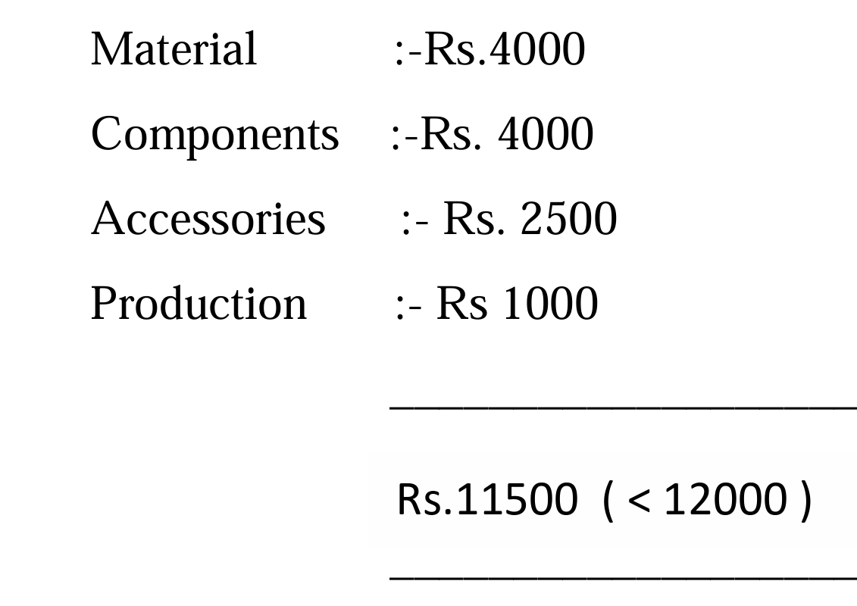
Cost Estimate ( Budget )

Slide 13
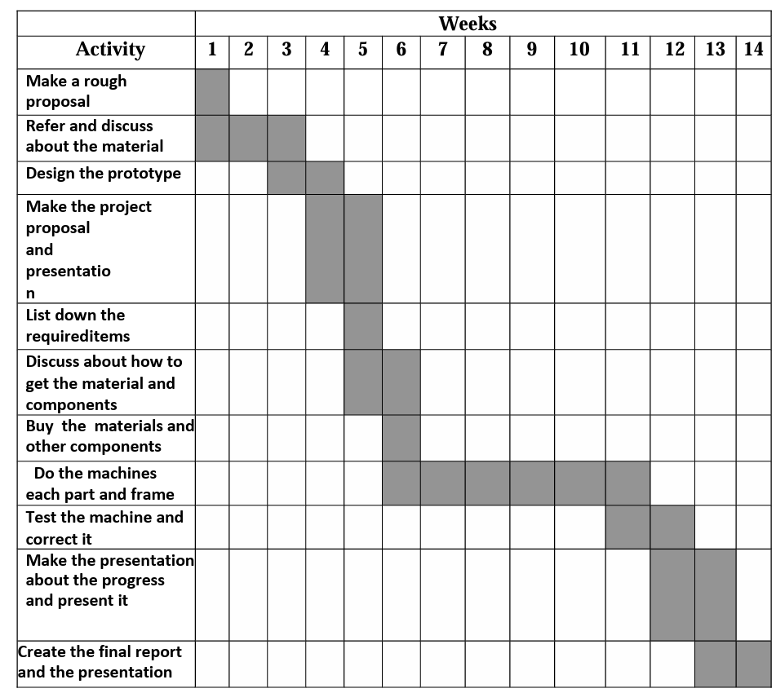
Timeline

Slide 14
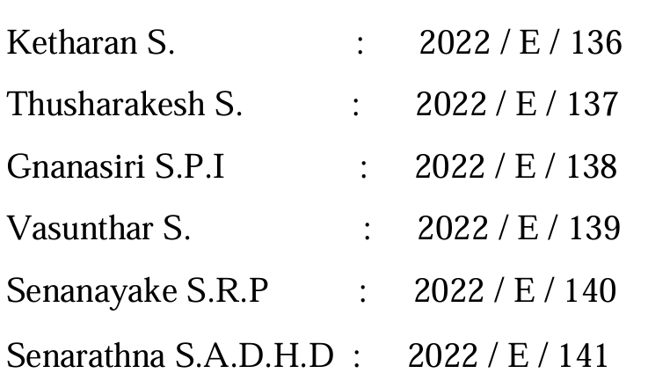
Group Members

Slide 15
Thank You

